Slide 1
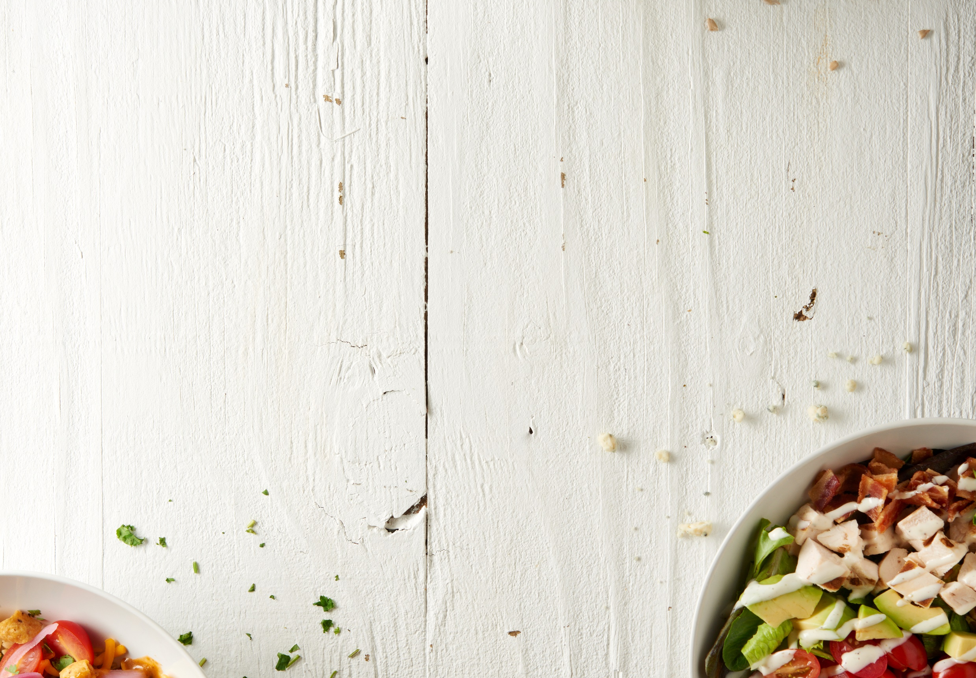

Now available in our grab & go coolers!
Fresh To Take Home
Meals for two for just $16.95
FRESH TO TAKE HOME
Indulge in Delicious Convenience

